Slide 1



Developing the North Central London Integrated Care System

Slide 2

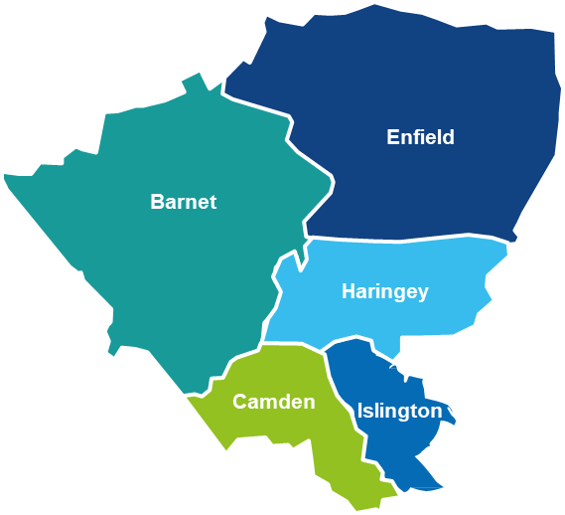
The North Central London population
In April 2020 the five Clinical Commissioning Groups in North Central London (NCL CCGs) – Barnet, Camden, Enfield, Haringey and Islington – merged to form one CCG.
Around 1.6 million residents, with a relatively young population in some boroughs compared to London average
Diverse population with historic high migration – from within UK and abroad; around 25% of people do not have English as their main language
Higher rates of deprivation than some London areas, with pockets of deprivation across all boroughs
Significant variation in life expectancy between most affluent and most deprived areas
¹ Index of Multiple Deprivation, 2019

Slide 3
The North Central London health and care system
12 hospital trusts
5 local authorities
One clinical commissioning group
200+ general practices
300+ pharmacies
200+ care homes
Countless voluntary sector organisations and community groups providing essential care
¹ Index of Multiple Deprivation, 2019

Slide 4
Building on strong NCL partnership foundations to form our ICS

Slide 5
The formation of Integrated Care Systems
Integrated Care Systems (ICS) are a new form of partnership between organisations that support the health and wellbeing of local communities. Partners include the NHS and local councils alongside voluntary, community and social enterprise sector organisations
In April, the Department of Health and Social Care published a White Paper (February 2021): ‘Integration and Innovation: working together to improve health and social care for all’.
Government and Parliament will establish ICSs in law and remove legal barriers to integrated care for patients and communities. Decisions on legislation will be for Government and Parliament to make.
From 1 April 2022, Integrated Care Systems (ICSs) will become fully operational as statutory organisations responsible for strategic commissioning, with a financial allocation set by NHS England. In North Central London, our ICS will operate in shadow form this financial year.

Slide 6
The core purpose of an Integrated Care System
To improve outcomes and wellbeing, through delivering equality in health and care services for local people. Supporting them to Start Well, Live Well and Age Well. We also want to support the many local people who are employed by health and social care to Work Well.
The core purpose of an Integrated Care System is to:
      improve outcomes in population health and healthcare
      tackle inequalities in outcomes, experience and access
      enhance productivity and value for money
      help the NHS to support broader social and economic development.
Each ICS will have a responsibility to coordinate services and plan health and care in a way that improves population health and reduces inequalities between different groups.
This way of working closely reflects how the NHS and Councils in North Central London have already been working together in recent years, to improve our population’s health and reduce inequalities through greater collaboration.

Slide 7
Benefits of forming an ICS in North Central London
Improved Outcomes
Enable greater opportunities for working together as ‘one public sector system’ – ultimately delivering improved patient outcomes for our population
Working at Place
Support the further development of local, borough-based Care Partnerships and Primary Care Networks
Reduce inequalities
Identify where inequality exists across in outcomes, experience and access and devising strategies to tackle these together with our communities
Economies of Scale
Help us make better use of our resources for local residents and achieve economies of scale and value for money
System Resilience
Help us become a system with much greater resilience to face changes and challenges to meet the needs of our local population by supporting each other.
Efficient and Effective
Help us build a more efficient and effective operating model tackling waste and unwarranted variation.

Slide 8
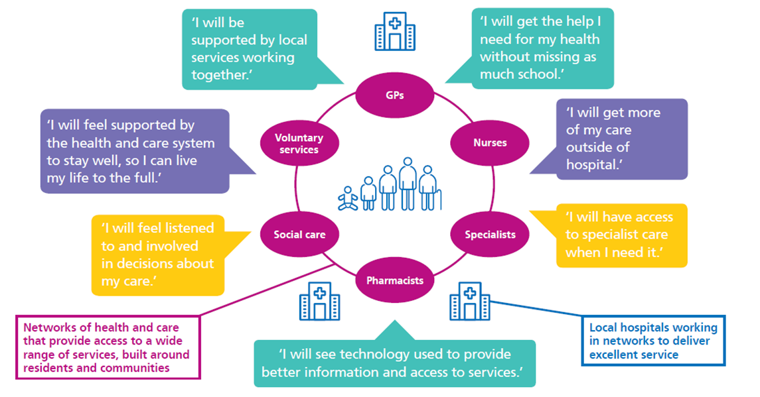
What will this mean for residents?
Faster progress towards what residents have told us they want from local services:

Slide 9
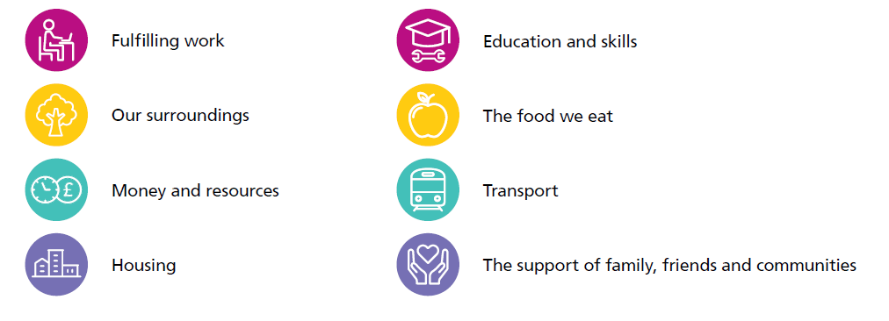
What will this mean for residents?
And an increased system-focus on the wider determinants of health and wellbeing:

Slide 10
Governance and structures of the NCL ICS

Slide 11

Working towards an NCL ICS
Together, system partners are designing what our Integrated Care System (ICS) will look like at neighbourhood, place and system-level
Neighbourhood network
Neighbourhood network
Neighbourhood network
Neighbourhood network
Neighbourhoods build on the core of the primary care networks and enable greater provision of proactive, personalised, coordinated and more integrated health and social care through multidisciplinary teams taking a proactive population based approach to care at a community level.
5 x Place-Based Partnerships
Boroughs are the critical point of integration and coordination of services. All boroughs have a strong sense of defined population being coterminous with local authorities. The work at borough partnerships is focussed on bringing together partners develop and coordinate services based on agreed outcomes.
Public engagement and resident voice
NCL ICS
The NCL ICS will focus on activities that are better undertaken at an NCL level where a larger planning footprint increase the impact or effectiveness of these functions. It will also be responsible for system planning, towards our goals of reducing inequalities and improving health outcomes.

Slide 12

Islington Borough Partnership: Fairer Together
Building on many years of effective partnership working, the Islington Borough Partnership was established in February 2020. Locally the partnership is known as the Fairer Together Borough Partnership.
The Islington Fairer Together Borough Partnership includes a wide range of local organisations to develop and coordinate services, including:
Local Authority
NHS
Police
Fire Service
Voluntary Sector
The partnership meets regularly to determine local priorities and develop and oversee collaborative approaches to improving population health and outcomes.
Islington

Slide 13
Islington Borough Partnership: Fairer Together
The Islington Fairer Together Borough Partnership is working collaboratively to join up services across a range of areas:
Building on many years of effective partnership working, the Islington Borough Partnership was established in February 2020. Locally the partnership is known as the Fairer Together Borough Partnership.
Health Inequalities
We are working together to tackle inequalities, including using NHS funding to:
Improve physical health for adults who have a mental health need
Support people with respiratory conditions to access local services & develop self-management approaches
Deliver First Aid Mental Health training to local community leaders to help support young black males
Pandemic Response
When the pandemic struck, we worked together to support delivery of things like food vouchers and pulse oximeters to those who needed it.
Islington
COVID Vaccination
Our Covid vaccination programme has been a success because local people have volunteered as marshals and the council has helped the NHS find different venues like the Emirates and schools
Employment
Across our partnership we are working with colleges and employment services to help local people get into employment – particularly across the NHS and social care
Mental Health Support
We are working together to develop a new model of mental health provision in GP practices to better support patients.

Slide 14
Clinicians at the heart of our NCL ICS
Future clinical leadership
Clinical leadership will remain at the centre of the NCL ICS - at system, place and neighbourhood level
Must reflect the multidisciplinary nature of an ICS, and the diversity of our population
Continued need for primary care clinical leadership
Setting objectives for effective partnership working between clinical and professional leaders, officers and system partners to provide high quality health and care for NCL patients and residents

Slide 15
Building resident and community voices at the heart of our ICS

Slide 16
Community involvement and representation
Health and Wellbeing Boards are linked to all borough partnerships:
Most boroughs have updated their Health and Wellbeing Board ToR to include a link to the Borough Partnerships.
Cllrs are largely engaged through the HWBB although there is increasing interest in direct involvement.
HASCs also regularly request reports on the development of integrated care locally.
Health and Wellbeing Boards
Patient and resident engagement is being undertaken in different forms across borough partnerships:
All partnerships have their local Healthwatch as members on their partnership groups.
    Some Healthwatch members leads on specific areas of focus/priorities within the partnership.
    Most ICPs have engagement groups (e.g. Haringey Citizen Health & Care Advisory Board, Camden Citizens Assembly, Islington conducts regular community engagement events).
    Some CCG borough teams also support a patient engagement forum, with resident and VCS representation.
    CCG Community Members sit on many of our committees and support wider engagement work.
Patient & resident involvement & engagement
Engaging the VCS
    Voluntary & community sector organisations play a role in all partnerships:
    VCS is represented on all partnership groups across all boroughs. In some, VCS leads on priorities areas (for example MIND in Camden alongside CIFT).
    In all others they are “plugged into” the work and have played an increasingly significant role in delivery of partnership plans (social prescribing, mental health and wellbeing support, delivery of equipment, support to access services, support to comms campaigns such as flu).

